Slide 1

AI3617 Game Theory
Course Project
Group 4
李天骅 毛宇琛 王鼎居 王凯灵 谢炜基
1

Slide 2
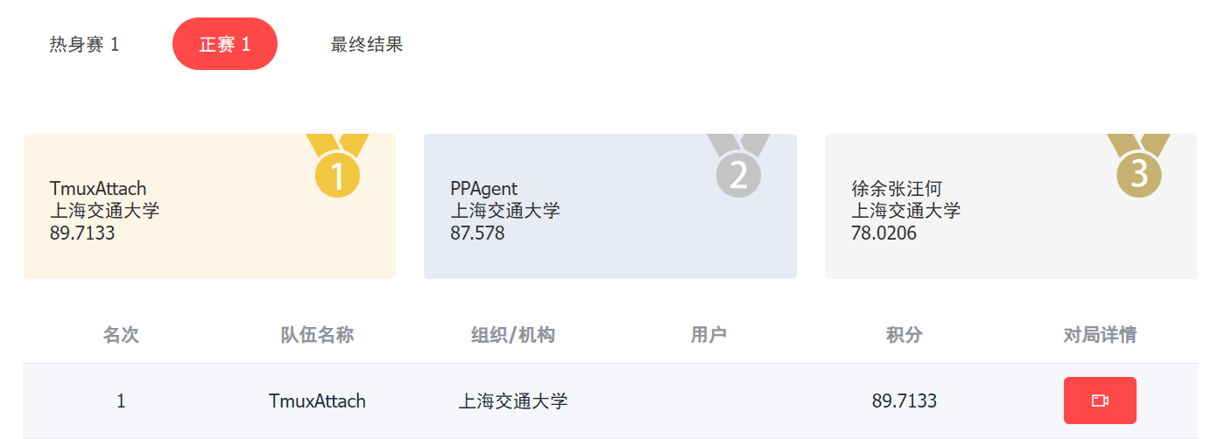
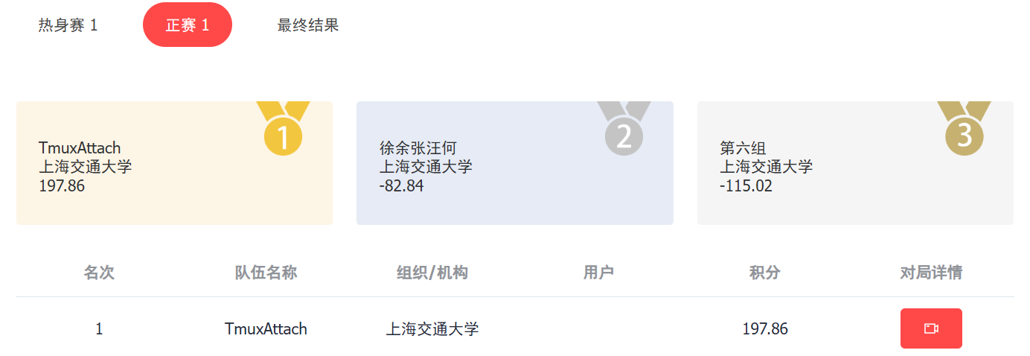
We are the champion!
In the open scenario, our agent defeated all opponents without losing!
2

Slide 3
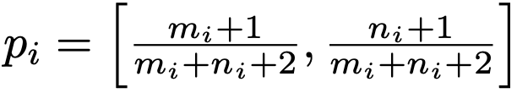
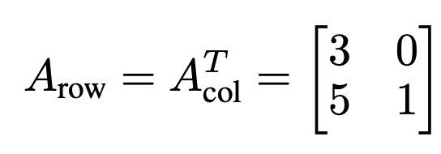
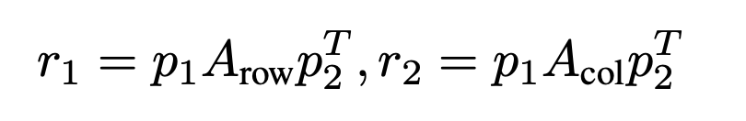
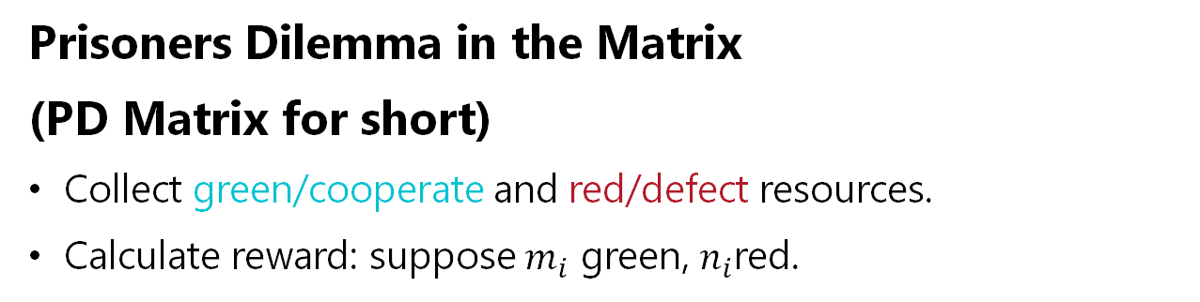
Introduction
Prisoners Dilemma in the Matrix
(PD Matrix for short)
  Collect green/cooperate and red/defect resources.
  Calculate reward: suppose $m_{i}$ green, $n_{i}$red.
3

Slide 4
Introduction
Clean Up
  7 players are rewarded for collecting apples (reward +1)
  Pollution accumulates at a constant rate
  Apple growth rate is linear to the amount of pollution
4

Slide 5
Solution Overview
Rule Based Agent (for PD matrix only)
RL Based Agent

Slide 6
Rule Based Agent
6

Slide 7
Rule Based Agent: Insight
The design of the rule should cover both purposes:
Fixed Scenarios
Open Scenarios
As much reward as possible
More reward while beat opponent
Good policy
Efficient gaming
Tend to betray
Ensure reward
7
Notes:
首先说明策略的设计思路。针对两个测试场景，在fixed scenario中，我们希望在有限的时间步中得到更多的reward。那么我们一方面可以设计更好的策略，在每轮游戏中获得更高的reward，另一方面我们希望高效的结束游戏，获得更多的轮数。
在open scenario中，我们既希望打败对手，又希望获得尽可能多的reward。想要打败对手的话，需要更多的背叛；想要更多的reward，又需要观察对手策略是否合作。
（33s）

Slide 8
Rule Based Agent: Key
Key of design:
Dynamic Policy Sampler: To estimate opponent’s policy and react
Efficient behavior logic: End game quickly and hinder the opponent
8
Notes:
考虑到这些点，我们提出了两个设计策略的关键点：第一是需要估计对手策略，并进行决策。第二是高效的行动算法，快速结束游戏和阻碍对手。
(12s)

Slide 9
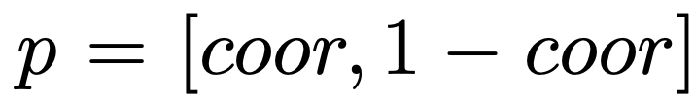
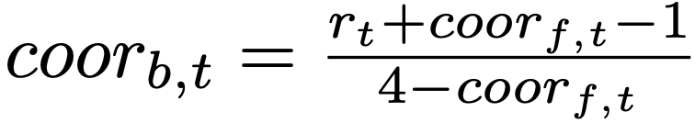
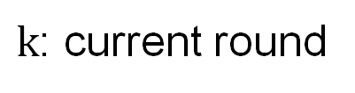
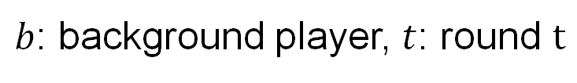
Rule Based Agent: Policy Sampler
First round: Cooperate
From second round:
    Let
$b$: background player, $t$: round $t$
$k$: current round
9
Notes:
对于第一点，我们设计了一个策略采样方法。
从第二轮开始，我们首先通过观测的reward反推对手收集情况，用这个合作概率参数表示。我们将对手的历史策略进行加权，计算一个高斯分布参数。
为了降低采样的不确定性，我们使用一半的方差进行采样，作为对手下一步策略的估计值。我们在这个采样值的基础上，减去两倍的方差，作为我方的策略。最后，我们把这个概率规约到整数的收集目标。

Slide 10
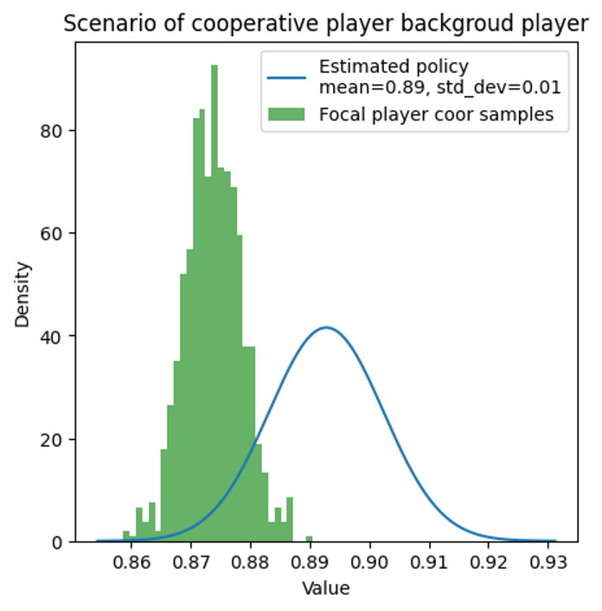
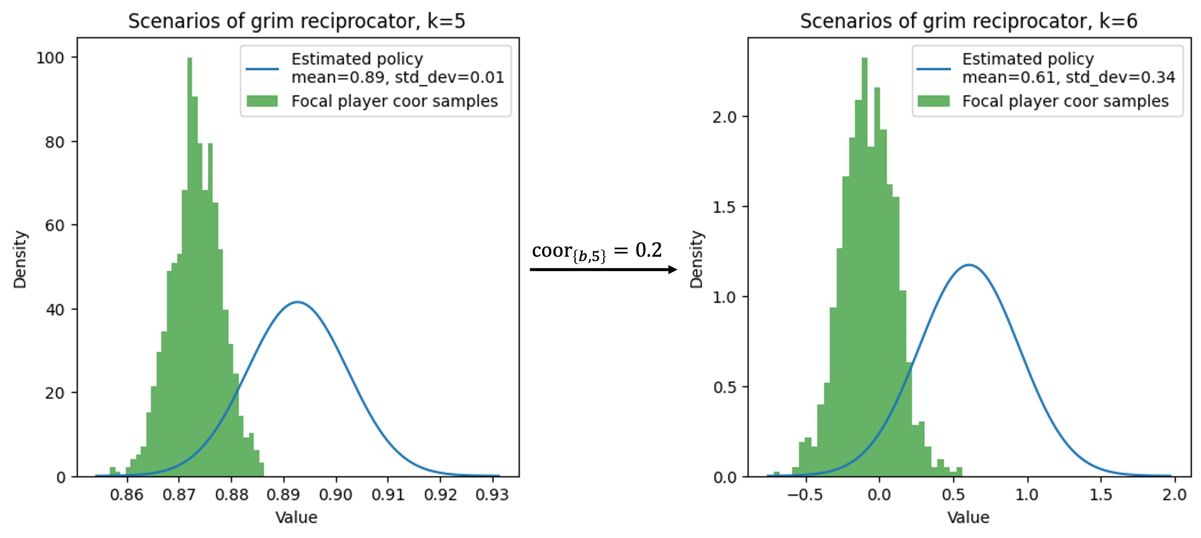
Rule Based Agent: Policy Sampler
10
Notes:
估计步按时间加权的思路很简单，就是希望应对触发式的对手，就比如最后一个场景，一旦背叛就一直背叛。当观察到对手策略出现巨大变化的时候，我们的agent可以快速的跟上估计。比如说右边的例子展示了触发式对手，原本合作概率有0.8，0.9左右，在第六轮游戏被触发，合作概率只有0.2。那么对手的估计值很快就从0.86移动到了0.59。
我们主要看最后采样的式子。比较疑惑的点是为什么减去方差，以及为什么常数是2。
首先，减去的这个部分，对应的意义是背叛的倾向。左边这张图展示了一个总是合作的对手，可以看到方差是非常小的，相应的背叛倾向就小，我们实际上在模仿对手。右边的图，由于策略突然改变，方差突然增大，所以实际上的策略几乎会变成纯背叛。另外，对于50%的概率合作，以及纯随机的智能体，均值是0.5，方差是0.3左右，带入上式，合作概率基本上小于0。在这两个场景下，这个采样方法也会以最优的纯背叛策略去应对。

Slide 11
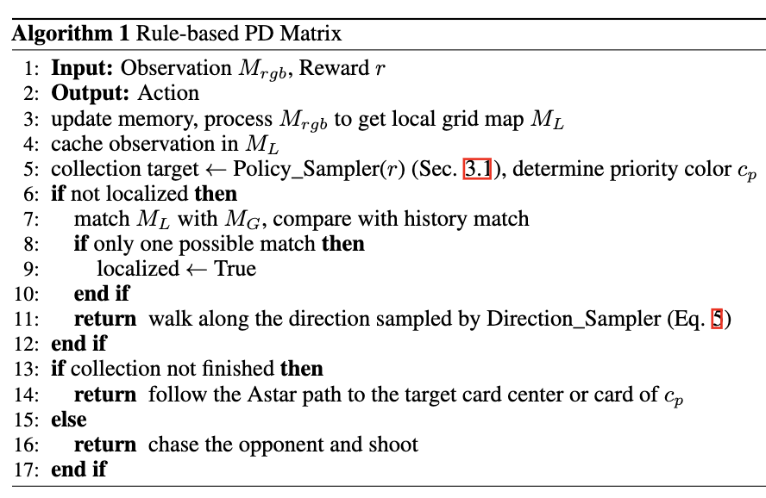
Rule Based Agent: Behavior Logic
Direction Sampler: walk away from walls
Localization: finish in 2-3 steps
Astar Path Planning
Seek opponent and hit
Over 400 lines of code for Behavior Logic
11
Notes:
然后是第二点，行为逻辑不分。这一部分主要是实现比较复杂，不涉及博弈，就简单介绍下。
首先智能体是在最外面的围墙生成的，首先让智能体原理墙走，在2-3步内一定可以完成定位。
然后使用一个带有短期记忆的Astar寻路算法，先收集目标里较多的颜色，导航到对应资源的中心。完成收集以后，一边前往在地图中心一边主动寻敌，发现对手，就主动导航到对手并且射击，尽可能快的结束游戏。在一些情况下，这个智能体可以在对手收集完以前就击中对手，那么对于纯背叛的对手，可以让对手背叛比例降低，我方可以占优势。

Slide 12
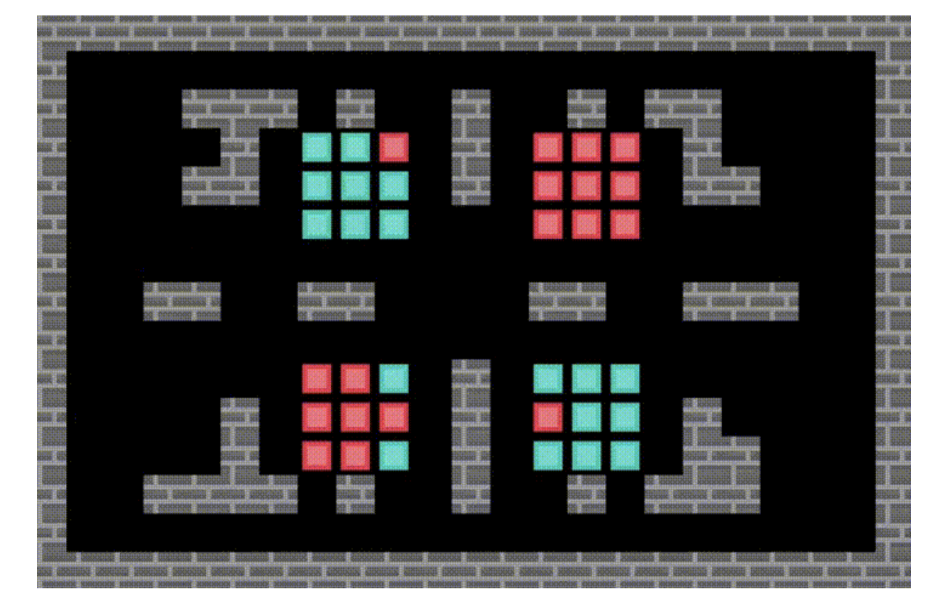
Rule Based Agent: Behavior Logic
Direction Sampler: walk away from walls
Localization: finish in 2-3 steps
Astar Path Planning
Seek opponent and hit
Over 400 lines of code for Behavior Logic
12
Notes:
然后是第二点，行为逻辑不分。这一部分主要是实现比较复杂，不涉及博弈，就简单介绍下。
首先智能体是在最外面的围墙生成的，首先让智能体原理墙走，在2-3步内一定可以完成定位。
然后使用一个带有短期记忆的Astar寻路算法，先收集目标里较多的颜色，导航到对应资源的中心。完成收集以后，一边前往在地图中心一边主动寻敌，发现对手，就主动导航到对手并且射击，尽可能快的结束游戏。在一些情况下，这个智能体可以在对手收集完以前就击中对手，那么对于纯背叛的对手，可以让对手背叛比例降低，我方可以占优势。

Slide 13
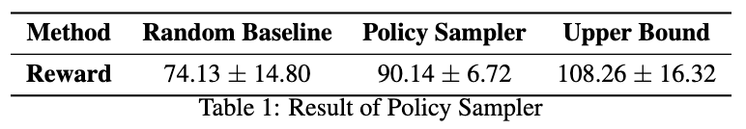
Rule Based Agent: Comparison
13
Notes:
Baseline是随机收集，Upper bound是已知对手策略，采取针对性策略。可以看到策略采样的方法只比上界低了不到20。这个20基本上是因为，在纯合作对手的10轮里面，最优策略是背叛，可以拿到5，但是我的方法会合作，只能拿到3。但是如果我们的方法选择背叛纯合作，又会丢掉最后一个场景的2分，可能是得不偿失的。所以实验证明，这个策略选择是良好的。

Slide 14
RL Agent
14

Slide 15
RL Agent
Ray Baseline: Independent PPO. Not so work, we discarded it after attempts.
  The code framework is too complicated to modify
  Naïve self-play suffers from severe inherent hardness. E.g.: nobody clean
Tess: An opensource RL solution of Melting Pot Contest
  Framework: Params sharing PPO + Multi-task + Self-play
  PPO Implementation:
    Impala Arch: CNN + LSTM + Output Head (Multitask Value & Actor)
    PopArt: Adaptive value normalization
  Multi-task: Design two task reward for each scenario
15

Slide 16
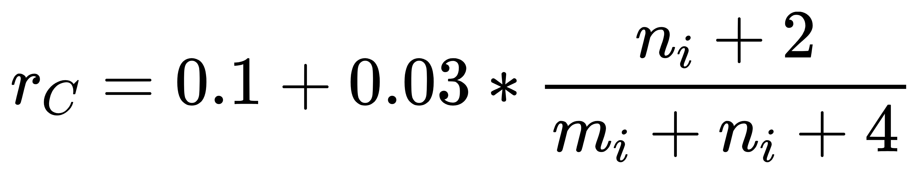
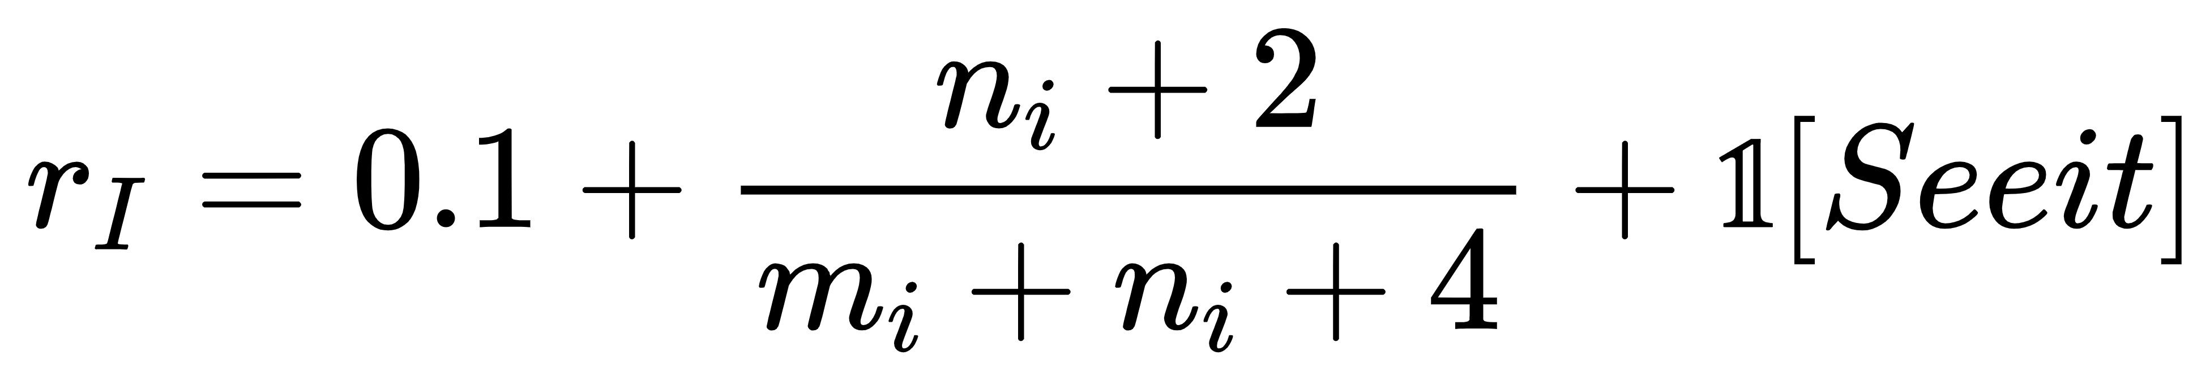
RL Agent: (RIN) Reward shaping Is all you Need
PD Matrix
Tess: Collection & Interaction Tasks
  Collection Reward: 0.1 for each collection of any color.
  Interaction Reward: sum of two players' game reward
  A Pure Cooperation Agent! Very friendly to PPO Learning
RIN: we need a Pure Betray Agent
  Collection Reward:
  Interaction Reward:
    Seeit Bonus: reward 1 when the first time agent sees the opponent
16

Slide 17
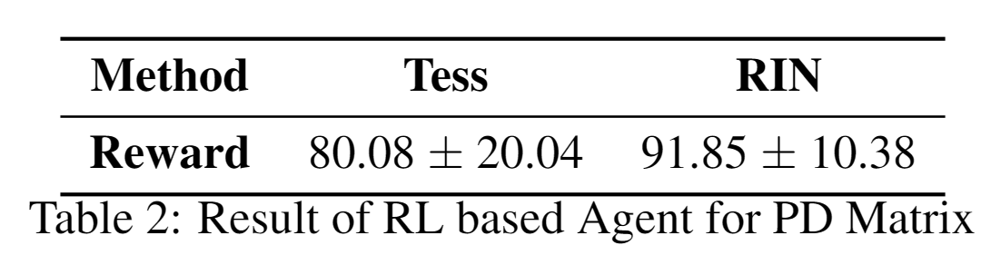
RL Agent: (RIN) Reward shaping Is all you Need
PD Matrix
17

Slide 18
RL Agent: (RIN) Reward shaping Is all you Need
Clean Up
Tess
  Clean Reward:
    0.1 for each cleared dirty.
    Keep 10 steps clean history. Whenever someone eat, every worker gets a reward of sum of its clean history
  Eat Reward: 0.1 for each apple
Underlying Idea: Hardworking should be consistently encouraged
Result: Easy training, but Uneven Distribution and Overproduction
18

Slide 19
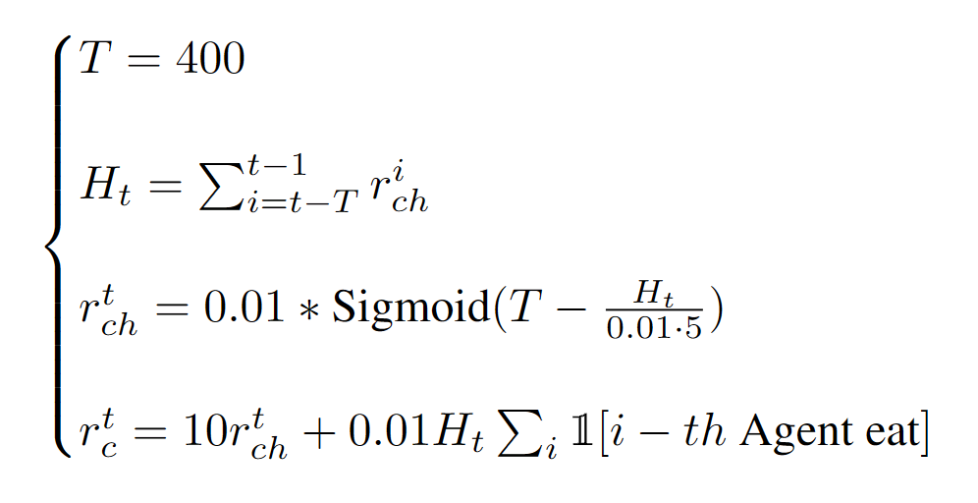
RL Agent: (RIN) Reward shaping Is all you Need
Clean Up
RIN:
  Idea: Shift Work is necessary
  Clean Reward:
    Keep 400 steps clean history
  Eat Reward: unchanged
  Successfully drive agents to Periodic shifts
19

Slide 20
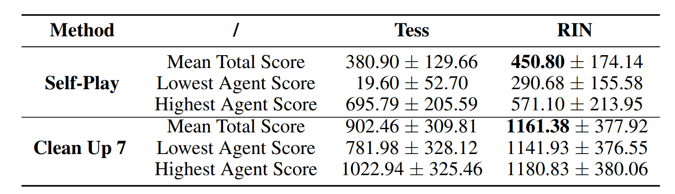
RL Agent: (RIN) Reward shaping Is all you Need
Clean Up
Self-Play: all 7 players are focal.
Clean Up 7: 5 bot, 2 focal player
  If 2 focal player go to clean, bots will go to clean spontaneously.
20

Slide 21
RL Agent: (RIN) Reward shaping Is all you Need
Clean Up
Demo: Self-Play
Tess
RIN
21

Slide 22
RL Agent: (RIN) Reward shaping Is all you Need
Clean Up
Demo: Clean Up 7
Tess
RIN
22

Slide 23
Conclusion
Rule Based
  Policy Sampler + Global Navigation
RL Based
  Modern PPO Impl. + Self-Play + Multitask
  Multitask reward:
    Explicit Advantage Decomposition
    Need to consider the benefits of teammates
  The right REWARD is the shortest path to success.
23

Slide 24
Team Contribution
王凯灵：Design and implement the rule-based. Experiments of rule-based part. Report writing. Presentation
谢炜基：Codes and Exps of RL based methods. Experiments, Report Writing, Presentation
李天骅： Review code of the Melting Pot env. Part of code and experiments running, Report Writing
毛宇琛：Survey. Part of experiments, Report Writing
王鼎居：Env analysis. Part of experiments, Report Writing
24

Slide 25
Resources
GitHub Repos：
  Source #1
  Source #2
  Source #3
  Documents：
  Melting Pot 2.0 [https://arxiv.org/abs/2211.13746]
有空就写没空删了
25

Slide 26
Questions & Answers

Slide 27
Thanks

